Slide 1

Thoughts on organizing code to make elbow plots
MISS VCOI

Slide 2
Reminder: MOV exit study (ES) workflow
Make data compatible with MISS VCQI
Run ES indicators
Examine MISS VCQI Log
Examine tabular & graphic output
Helpful hint: Look at RI_QUAL_09 output in R Shiny
Helpful hint: Use elbow plots to examine vaccination histories of the subset of children with eye-catching output; is there a pattern at the child level that explains patterns at the aggregate level??
In Pakistan and Nigeria we found that the combination of very late presentation for 6- and 10-week doses combined with a rigid bundling of IPV with the 14-week doses led to a pattern of high IPV MOSV prevalence.
In Pakistan, some facilities are contacting those children and asking them to come back in to receive IPV

Slide 3



One small obstacle to using this workflow
Code to make elbow plots is currently available only in Stata (and not publicly available)
If there is interest, after this meeting, perhaps we could start an activity to write some R code to make them
Until there is public code to make them, we at Biostat Global are always happy to make elbow plots for you

Slide 4
A Vision for Harmonized Indicators
Describe indicators clearly
Define survey dataset codebooks
Define survey variable preparation steps
Define specification for individual outcome indicators
Design software that does 3 & 4
Design software for stratum-level outcomes
Define common format for stratum outcomes
Foster creativity for tables, figures, maps, dashboards, reports, handouts, analyses, etc.
Share it all!!
MISS VCQI User’s Guide
MISS VCQI Forms & Variable Lists
MISS VCQI specifications document
MISS VCQI specifications document………… ………….
MISS VCQI (Stata & R)
MISS VCQI (Stata & R)
MISS VCQI (Stata & R)
……………………………………………………………………………………..
Shared on GitHub

Slide 5













Work With Result Datasets in Your Favorite Tool

Slide 6
Context
Elbow plots are not part of VCQI or MISS VCQI – they are something that we create using output files from VCQI and MISS VCQI. They were developed using internal funding and we have never shared the code to make them, though we have made them freely for all collaborators who wish to look at them.
The Stata code to make them was written as a “spare time activity” between 2018 and 2020 and has mostly not been enhanced since that time.
Several factors are sending us back for a closer look at the code:
I would like to add some features and add some new types of plots
It would be nice to have a version in R for our own analysts to use
If we teach survey data analysis, I think it’s fair to say that looking at these plots is a best practice and so we will want to be able to share the code to make them, or to give guidance to others who might want to write such code

Slide 7
Context
While we call them informally “elbow plots”, we sometimes use a more formal name “evidence and indicator plots”. See this supplement to this paper for what we’ve written about them that is in the public domain.
After a brief orientation, a reader should be able to look at the elbow plots and tell the story of the child’s immunization history, as listed in the evidence collected by survey workers. The reader should also be able to understand how VCQI or MISS VCQI have tabulated the indicator outcomes for that child.
This type of figure can be very helpful for confirming whether VCQI and MISS VCQI are getting the indicator outcome calculations right or not at the individual child level.

Slide 8
Context
We wrote code to make four types of plots so far and have ideas for more. In our MISS VCQI workshop, we focused on the first two types of plot.
Crude plot – simply shows the evidence that VCQI or MISS VCQI is evaluating (from card, register, or recall)
Crude MOV plot, overlays outcome indicators for MOVs (red diamonds) on the vaccination evidence & lists tabular output concerning number of visits eligible for the dose, number of MOVs, and corrected vs. uncorrected. This plot documents MOVs calculated under the so-called ‘CRUDE’ assumption that all doses count and health workers should not be expected to re-administer a dose later if it was given too early.
Valid plot: indicates whether the dose received was counted as a valid dose or not. And if yes, valid for which? (i.e., If the dose recorded in the Penta1 space was given too early, then perhaps the dose written in the Penta2 space on the card is counted as the valid dose for Penta1).
Valid MOV plot, overlays outcome indicators for MOVs (red diamonds) on the vaccination evidence & lists tabular output concerning number of visits eligible for the dose, number of MOVs, and corrected vs. uncorrected. This plot documents MOVs calculated under the so-called ‘VALID’ assumption that only valid doses count and health workers should be expected to re-administer a dose later if it was given too early. This form of accounting yields more MOVs than the CRUDE form. But probably the CRUDE calculations are more consistent with immunization practice around the world.

Slide 9
Current design & future plans
The programs that make each type of elbow plot being with VCQI & MISS VCQI output files. They trim down to needed variables and reshape to a dataset with one row per vaccination visit. They make some new variables.
But they also calculate quite a lot of the plotting parameters and syntax on the fly. They build up, using local macros, a very very long single plot command with sections described on the next slide. Some of the calculations and syntax are never saved. Simply constructed and run.
I’d like to make some changes to store *everything* that appears in the plot in a dataset and give an option for saving that dataset and an option for saving the syntax that generates the plot.
We should separate the code that does data management from the code that makes plots.

Slide 10
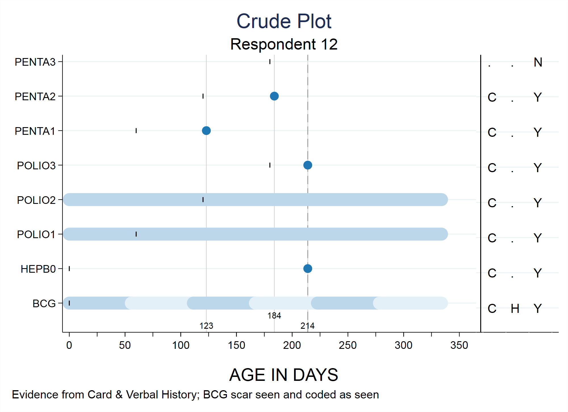
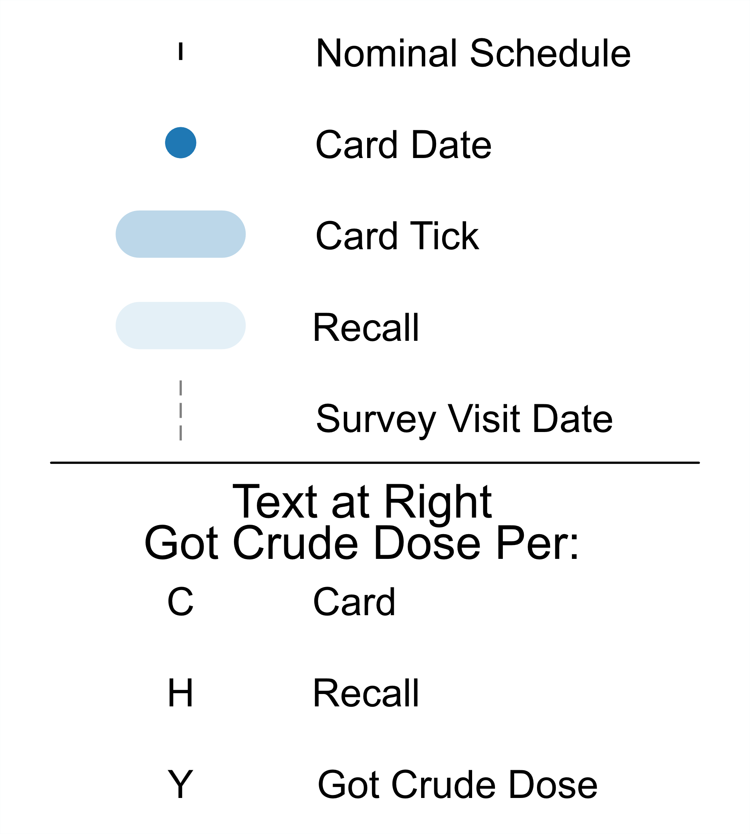

Slide 11
Crude Plot
Plot axes, dose names, faint horizontal lines for each dose; x-axis goes out to a logical max value
Plot vertical vx visit lines labeled with age in days at bottom, alternating y-coordinate of age labels
Plot nominal schedule
Plot card and/or register vx dates
Plot recall & tick evidence
Plot recall ‘Do not know (DNK)’ evidence
Plot age at survey or age on MOV study day (OSD)
Plot at right tabular crude coverage outcomes
Construct footnote listing sources of evidence and outcome of BGC scar
Construct title with respondent number and age at survey
Construct x-axis label

Slide 12
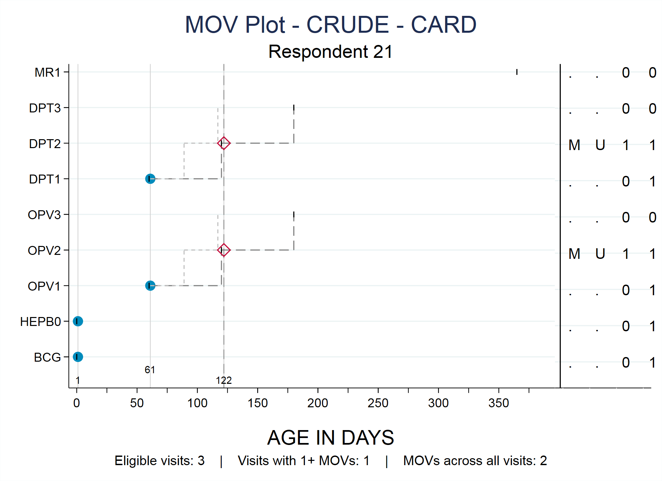
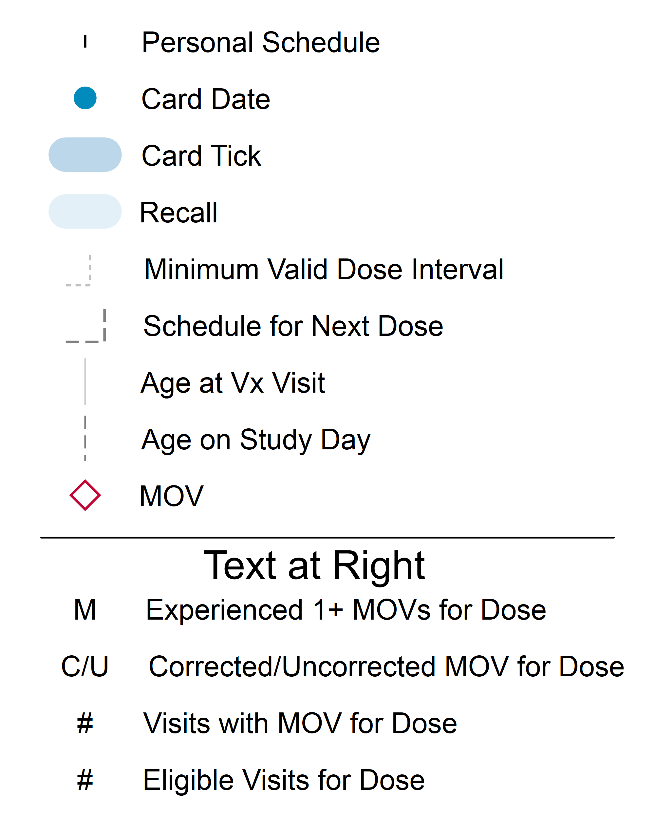

Slide 13
Crude MOV Plot
Plot axes, dose names, faint horizontal lines for each dose; x-axis goes out to a logical max value
Plot vertical vx visit lines labeled with age in days at bottom, alternating y-coordinate of age labels
Plot personal schedule: days until we would count next dose as eligible; days until scheduled for next dose
Plot card and/or register vx dates
Plot MOVs / MOSVs
Plot recall & tick evidence
Plot recall ‘Do not know (DNK)’ evidence
Plot age at survey or age on MOV study day (OSD)
Plot at right tabular MOV outcomes
Construct footnote summarizing MOVs
Construct title with respondent number and age at survey
Construct x-axis label

Slide 14
Data elements for Crude Elbow Plot
Dose abbreviation (by dose)
Y-coordinate (by dose)
Card date (by dose)
Register date (by dose)
Recall evidence (by dose)
Did caregiver say Do not know? (by dose)
Tick in original dataset (by dose)
Tick imputed by VCQI (by dose)
(Is there a hole in the evidence?) (by dose)
Counted as crude by card? (by dose)
By recall? (by dose)
By register? (by dose)
Counted as crude by any source? (by dose)
List of vx visit ages
Age on the day of the survey
Age on the study day (if an MOV survey)
X-label
Title, subtitle, footnote

Slide 15
Additional data elements for Crude MOV
Personal schedule – minimum interval (by dose)
Elbow start age (by dose)
Elbow end age (by dose)
MOV at which visits (age in days)
Any MOVs (by dose)
Corrected / Uncorrected (by dose)
Total visits with MOVs (by dose)
Total visits when eligible (by dose)
Title, subtitle, footnote

Slide 16
We will write up and circulate
What would be present in a complete dataset for making crude elbow plots
What variables
What VCQI / MISS VCQI datasets would they come from
What additional transformation or calculation needs to be done to make them plot-ready
We will write code to make some working datasets that can be used to develop plotting syntax
We will share some initial datasets
You all will be welcome to work with those datasets and try some ggplot2 syntax of your own
I will focus on Stata syntax
Cait & Mia will focus on R syntax, when we have spare time

Slide 17

Comments / Questions / Feedback ?

Slide 18
Dale.Rhoda@biostatglobal.com

